Slide 1

2023-2024 District Engagement Seminar
Ann Booth, D6200 ADPIC
August 19, 2023
Title Page Option

Slide 2

Overview
Club Public Image Goals
How Public Image can help your club
Telling Your People of Action Story
Social Media beyond Facebook

Slide 3
Goal I: Brand Awareness
Branding increases reach, awareness, interest, influence
When appearing in public, people must know that you are a Rotarian!!!
Wear Rotary branded items: hats, shirts, jackets, sweaters, pins, ties, etc. to all activities. Never take a photo without it!
Consider club purchasing for members (group discount)
Rotary’s official vendor is Russell-Hampton: https://www.bestclubsupplies.com/
Always wear Rotary!!!

Slide 4
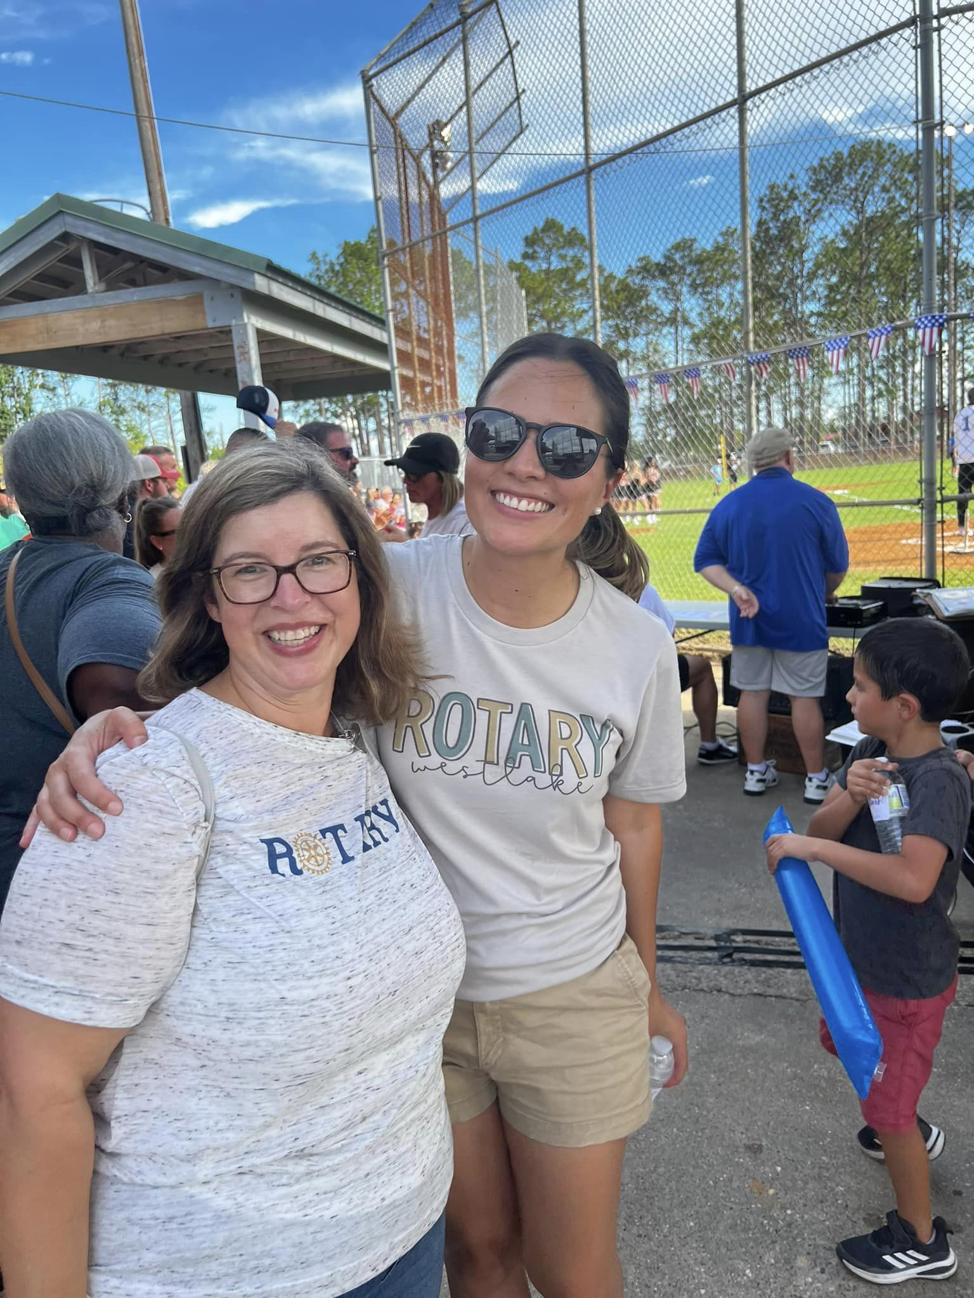
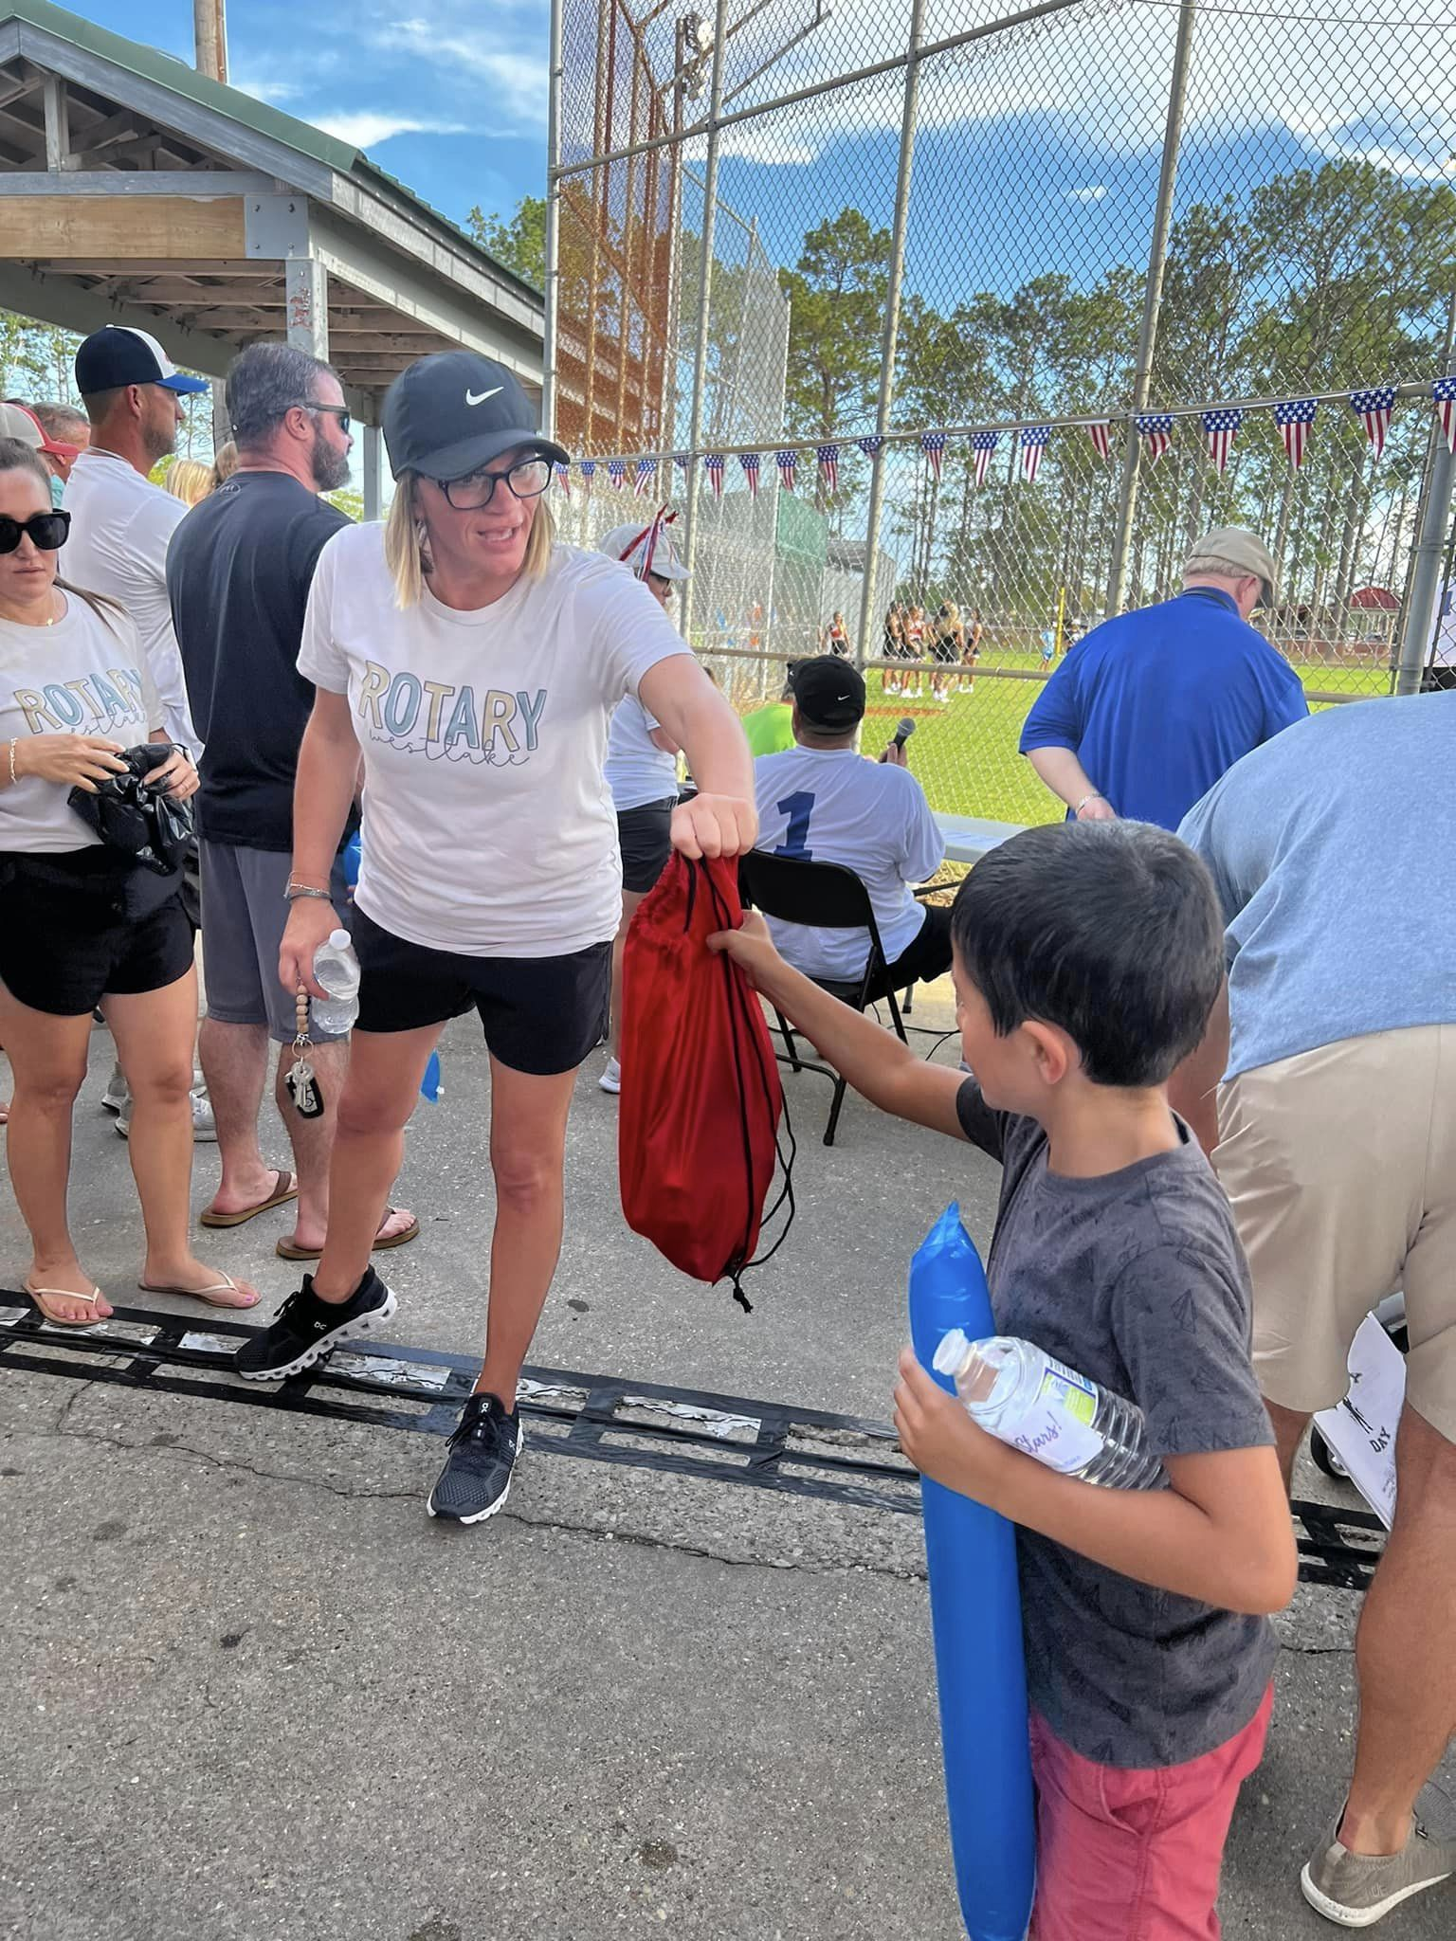
Goal I: Brand Awareness

Slide 5
Goal II: Public image training
Rotary International Public Image training
  In person/virtual meetings- District Conference, Zone Summit, Zone Leadership Seminar, PETS, club meeting presentation by District PI Chair
  Online- my.rotary.org, District webinars, District resources
Goal: 75% of all clubs in District 6200 to designate a Public Image Chair.
  Designate in DacDB
  Club Public Image Chair should receive training
  Only 10 clubs so far!!!

Slide 6
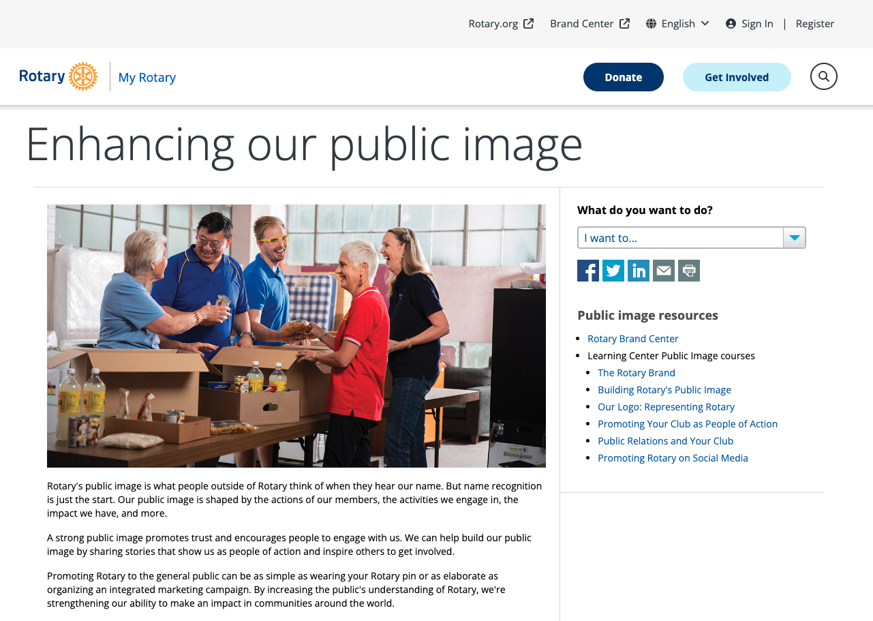
Online training- public relations
https://my.rotary.org/en/learning-reference/learn-topic/public-relations

Slide 7
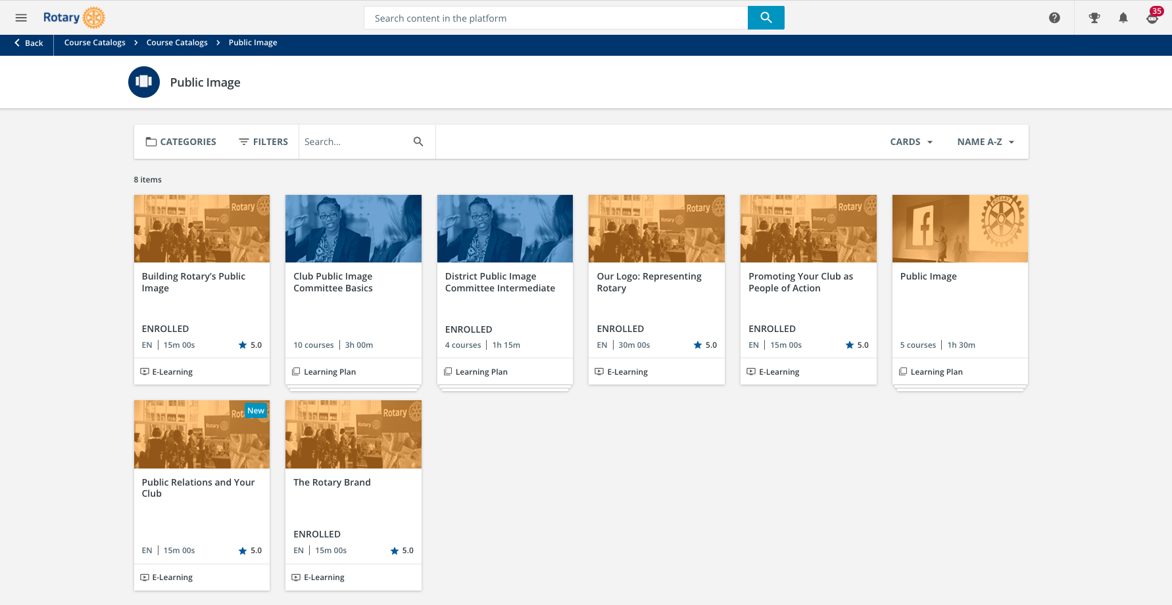
Learn Center
https://learn.rotary.org/members/learn/catalog/view/72

Slide 8
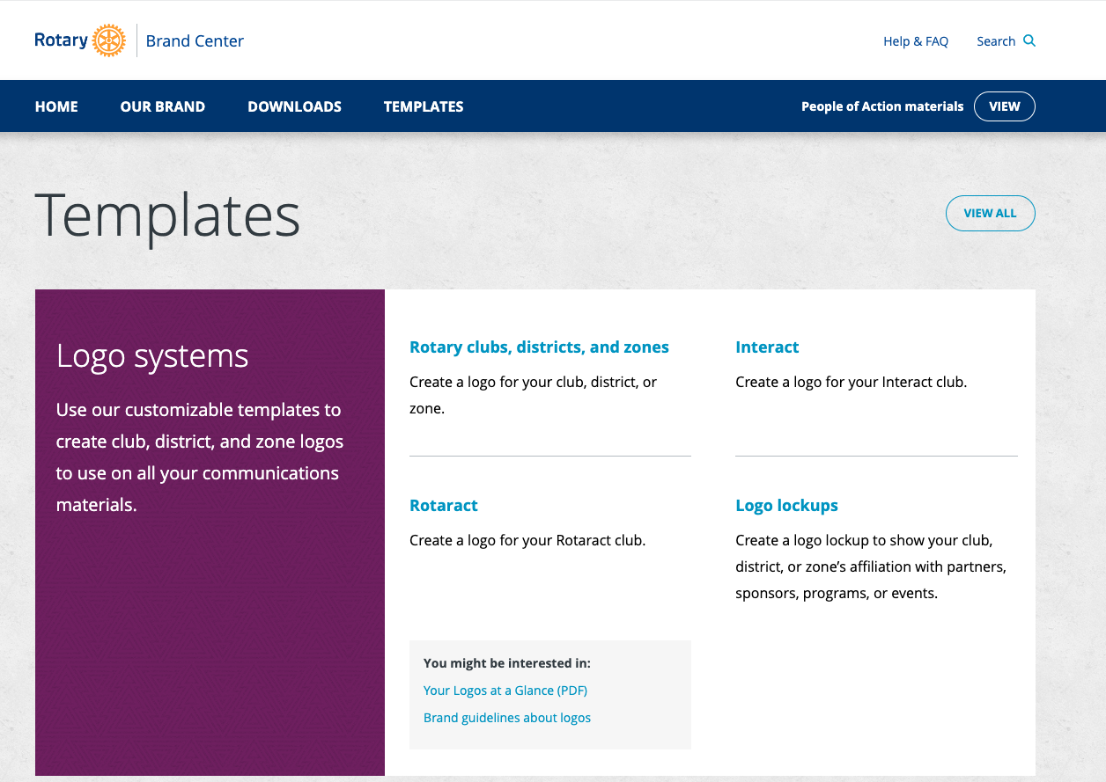
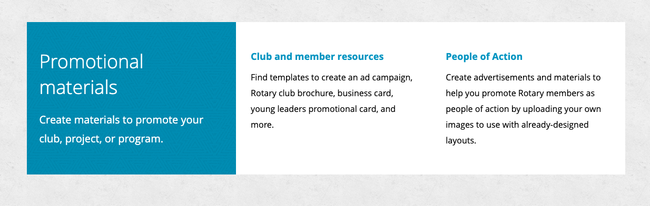
Rotary brand center
https://brandcenter.rotary.org/en-us/templates

Slide 9
Goal III: Increase club participation
Rotary clubs do good in their communities on an almost daily basis, but it often goes unrecognized
Goal: Each club in District 6200 should submit a photo, video, or write-up from a club activity at least twice during each Rotary year
  20 Clubs submitted so far!
  Material can be published in Newsletter, District Facebook page, District YouTube Page, and District Twitter Account

Slide 10
Goal III: Increase club participation
Like our District FB page: https://www.facebook.com/rotarydistrict6200/
Subscribe to our District YouTube Channel: Rotary District 6200
Follow our District X (previously Twitter) Twitter Handle: @RIDistrict6200
Follow our District LinkedIn page: Rotary District 6200
Follow our District Tik Tok page: @rotarydistrict6200

Slide 11
Goal III: Increase club participation- Hashtags
#rotarydistrict6200
#peopleofaction
#serviceaboveself
#rotary
#proudrotarian
#rotaryclubof (they would add the club name)
#rotaryinternational

Slide 12
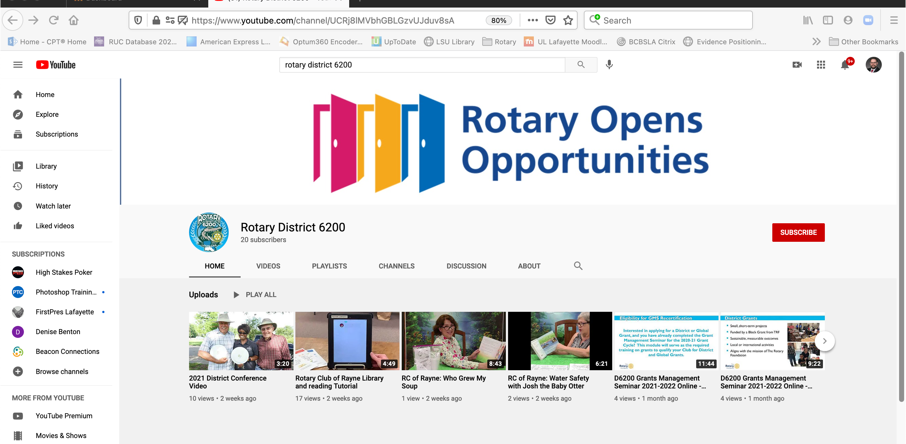
SUBSCRIBE TO YOUTUBE CHANNEL
Youtube.com
Search “Rotary District 6200”
Click
“Subscribe”
https://www.youtube.com/@RotaryDistrict-wy5zy

Slide 13
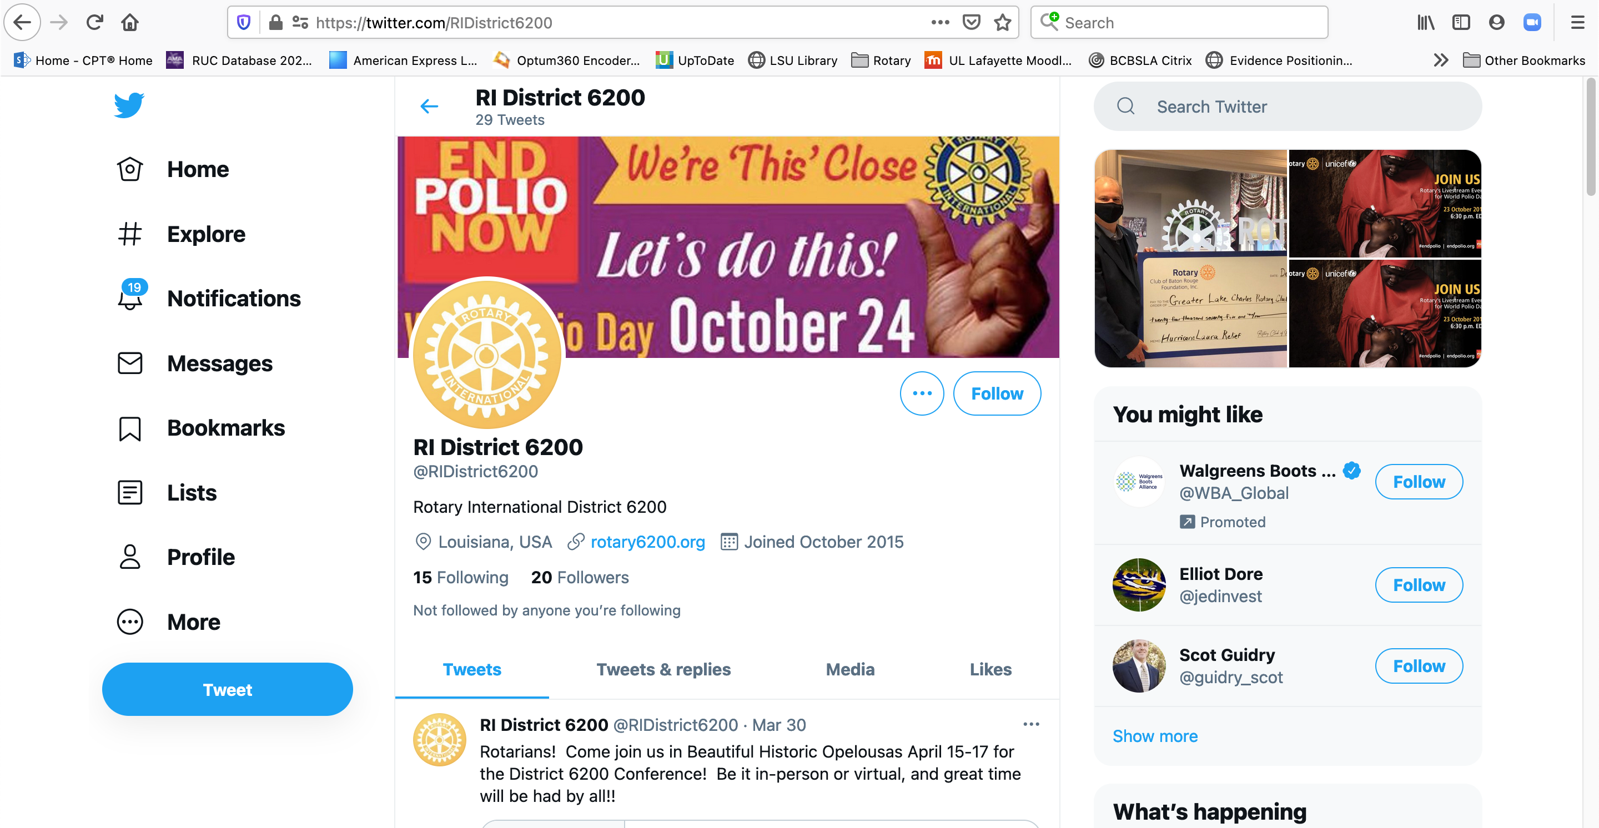
Follow us on X (Previously twitter)
Twitter.com
Search “RIDistrict6200”
Click “Follow”
https://twitter.com/RIDistrict6200

Slide 14
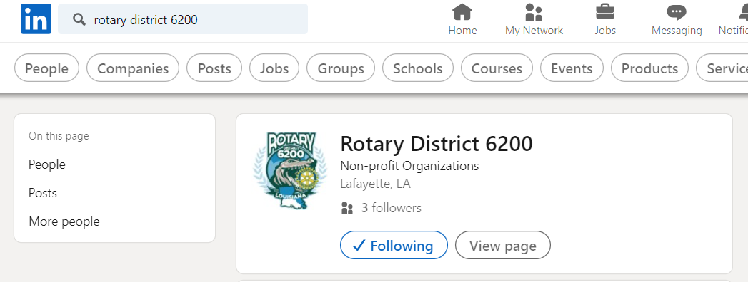
Follow us on LinkedIn
LinkedIn.com
Search “Rotary District 6200”
Click “Follow”
https://www.linkedin.com/company/rotary-club-district-6200/00

Slide 15
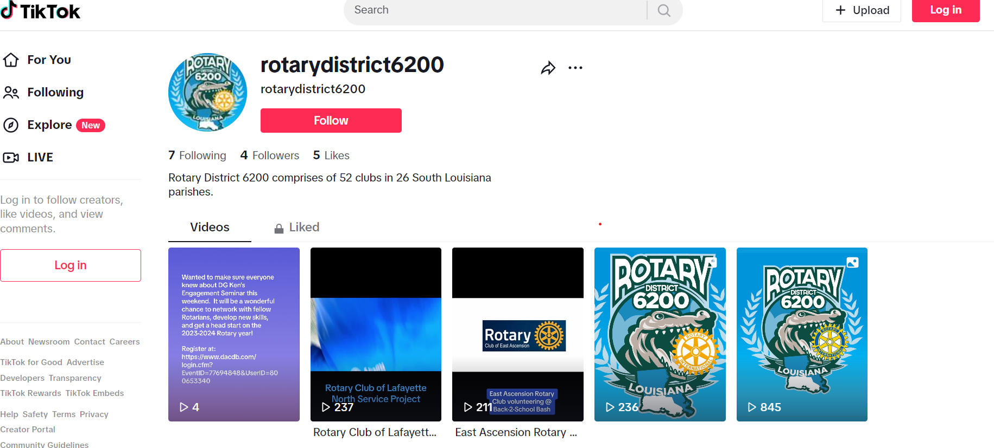
Follow us on
Tik tok
TikTok.com
Search “RotaryDistrict6200”
Click “Follow”
Click “Follow”
https://www.tiktok.com/@rotarydistrict6200

Slide 16


Photograph suggestions:
Action pictures (show your members having fun and in action!)
Always tag members in Facebook photographs
Remember to use hashtags (“#”)
Use ”People of Action” Branding (https://brandcenter.rotary.org)

Slide 17
Rotary brand center
https://brandcenter.rotary.org/en-us/templates

Slide 18
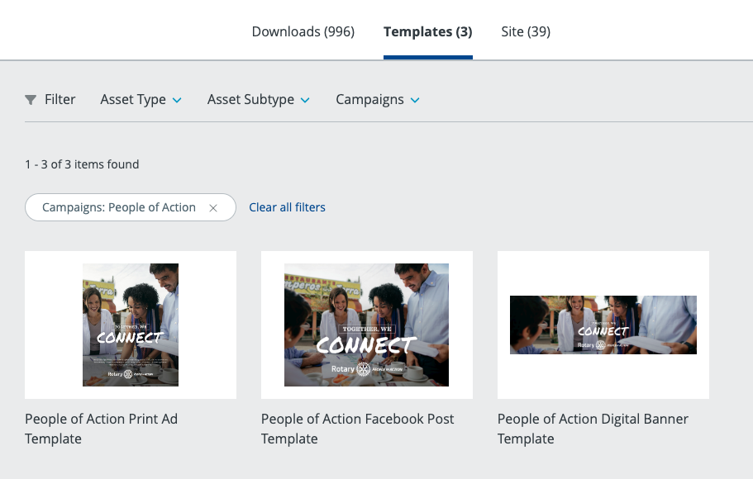
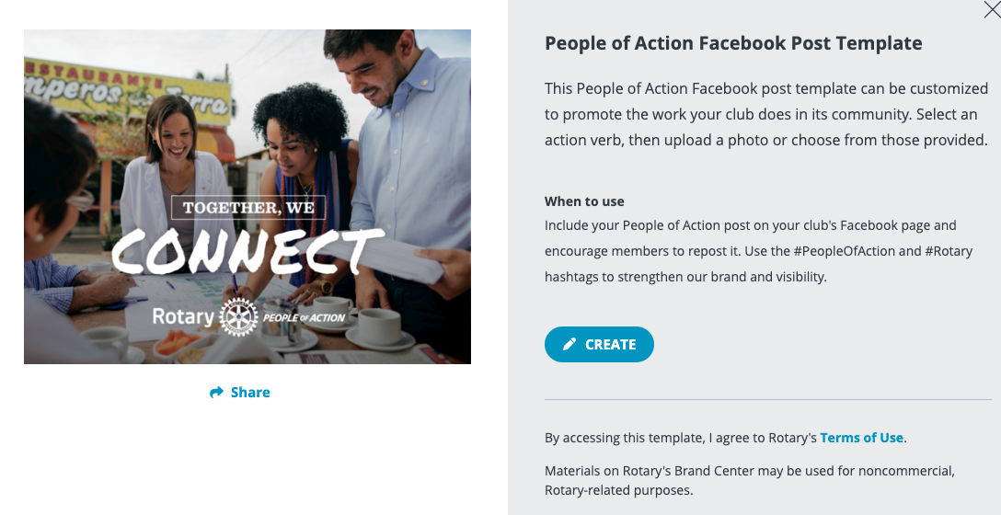
Rotary brand center

Slide 19
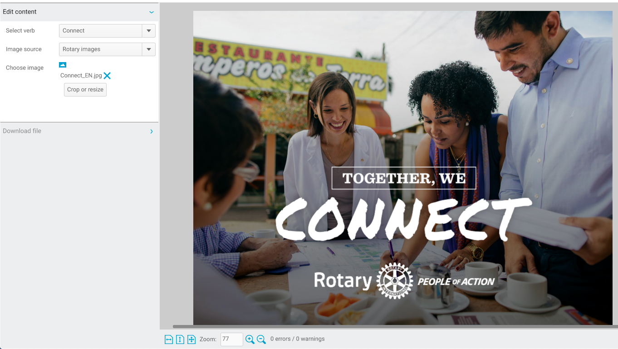
Rotary brand center

Slide 20
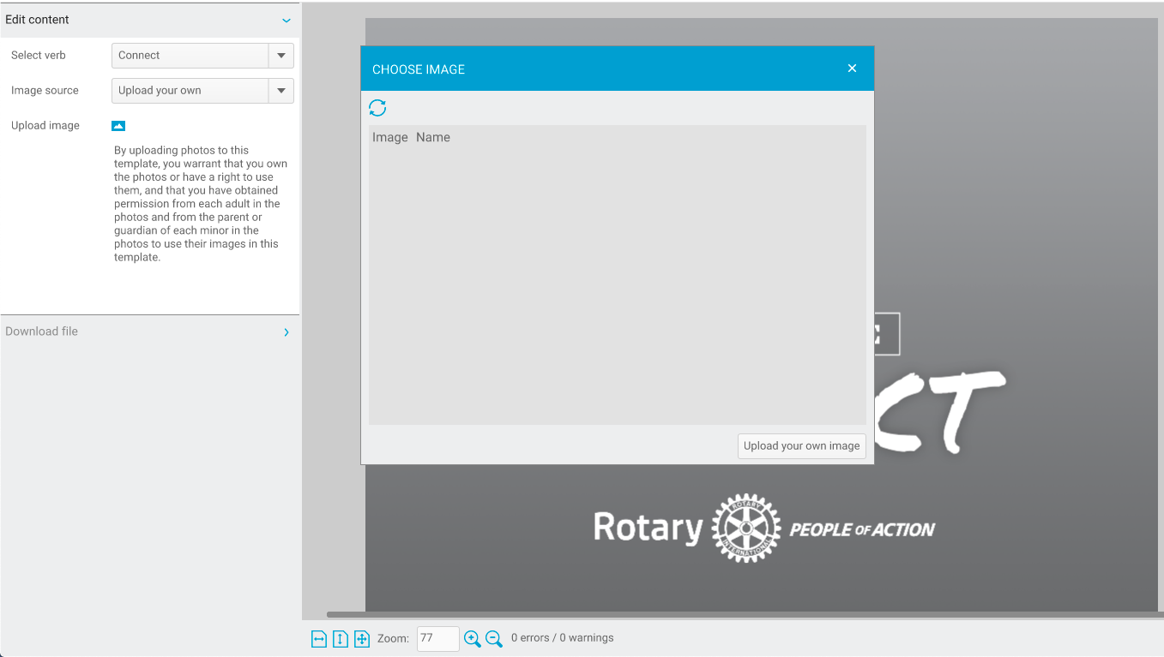
Rotary brand center

Slide 21


Rotary brand center

Slide 22
Lagniappe: grow online video presence
Creating video content has become easier with more affordable technology and the expansion of online platforms
Videos are be more impactful, garner more online interest, and tell a more complete story
Goal: Each club submit at least one real time video from a service project or other club event to the District online media platform (Facebook/YouTube) during the each Rotary Year.
Email video/link to Rotary6200PI@gmail.com
Subscribe to YouTube Channel!!!

Slide 23
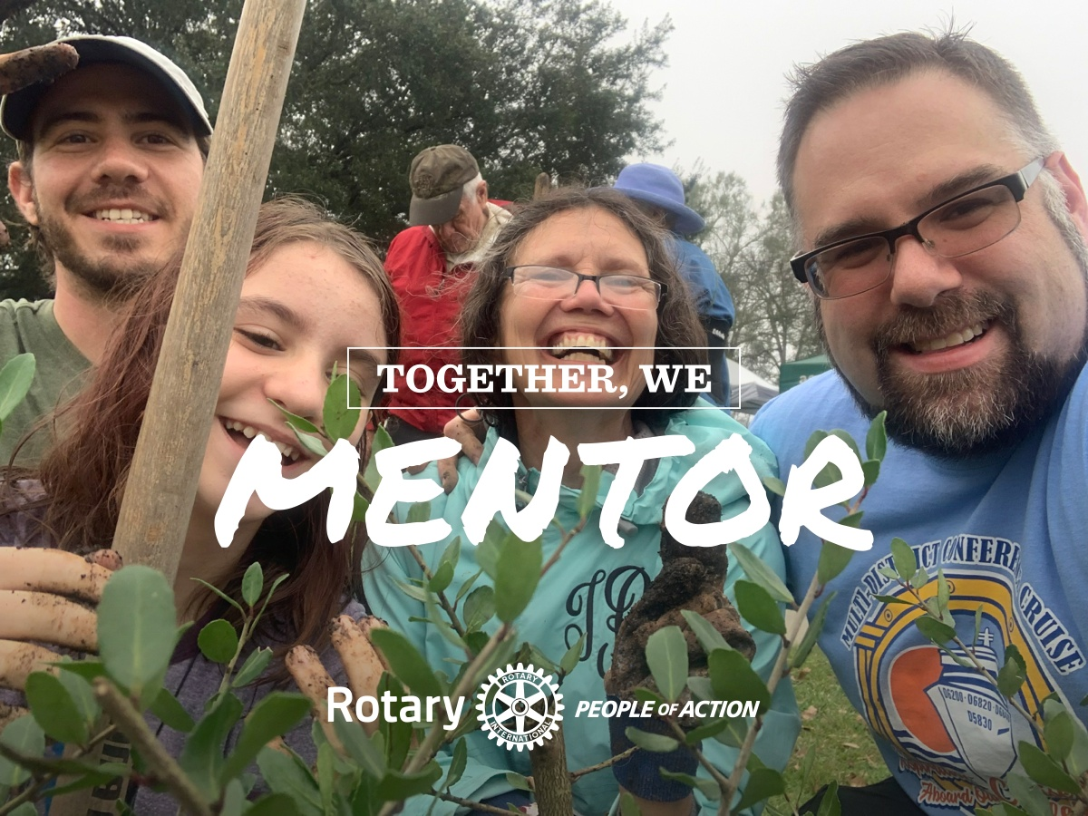
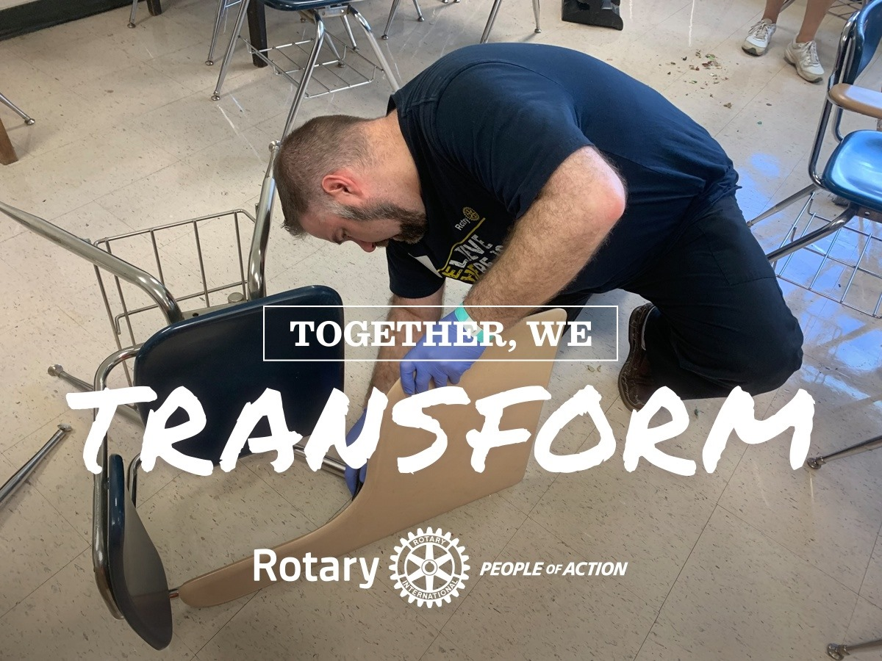
Summary
Public Image can spur growth and promote projects
Designate a Public Image Chair
Wear Rotary
Tell a story
Tag and use hashtags
Think beyond Facebook
Post at least twice throughout the year (live video)

Slide 24

Thank YOU!!!

Slide 25
QUESTIONS
Larry Simon
PIC District 6200
rotarydoc6200@gmail.com

